Slide 1


1
Jeshikanth Bellamkonda
Final Project
GITHUB:https://github.com/BJESHIKANTH/Apssdc_cs

Slide 2


Keylogger Application
2

Slide 3


3
AGENDA
1) Problem Statement
2) Project Overview
3) End Users
4) Solution and Value Proposition
5) The Wow Factor
6) Modelling
7) Results

Slide 4


PROBLEM STATEMENT
The Challenge:
Tracking keystrokes for security, research, or productivity analysis purposes can be cumbersome and inefficient without the right tools. Existing solutions may lack user-friendliness or detailed
logging capabilities.

Slide 5


PROJECT OVERVIEW
This project involves developing a keylogger application using Python and Tkinter. The keylogger captures keystrokes, logs them in text and JSON formats, and offers a user-friendly interface to start and stop the logging process.
6/13/2024 Annual Review 5

Slide 6
WHO ARE THE END USERS?
.Security Analysts: To monitor and detect unauthorized activity.
.Researchers: For studies requiring data on user interaction.
.Productivity Analysts: To assess and improve typing efficiency.
.IT Professionals: For troubleshooting and debugging.
6/13/2024 Annual Review 6

Slide 7

YOUR SOLUTION AND ITS VALUE PROPOSITION
Keylogger Solution:
.Ease of Use: Simple interface to start and stop logging.
.Comprehensive Logging: Captures keystrokes in both text and JSON formats for versatile usage.
.Real-Time Monitoring: Immediate feedback on the
keylogger's status.
Value Proposition:
.Efficiency: Quickly deploy and manage keystroke logging. .Detail-Oriented: Provides thorough and structured logs.
.Versatility: Applicable in various professional and research contexts.
6/13/2024 Annual Review 7

Slide 8

THE WOW IN YOUR SOLUTION
•User-Friendly Interface: Intuitive GUI built with Tkinter.
•Detailed Logs: JSON and text formats for easy analysis.
•Real-Time Updates: Immediate visual feedback on
keylogger status.
3/21/2024 Annual Review
8

Slide 9
MODELLING
Technical Implementation:
•Languages and Libraries: Python, Tkinter, pynput, json.
•Core Functions:
•generate_text_log(key)
•generate_json_file(keys_used)
•on_press(key)
•on_release(key)
•Key Features:
•Logging keystrokes in multiple formats. •Simple start/stop functionality.

Slide 10
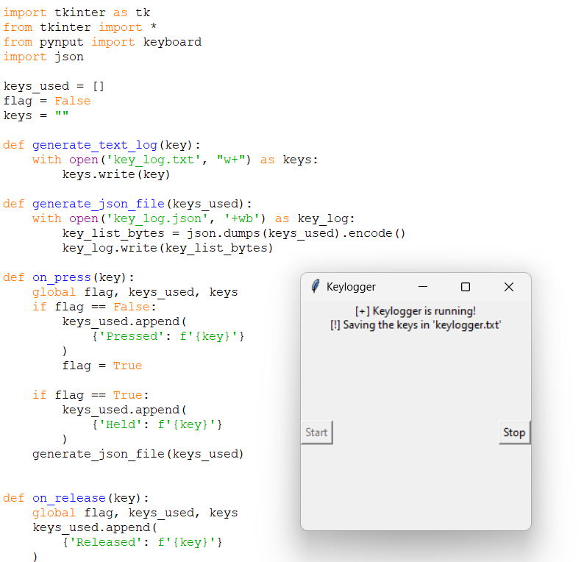
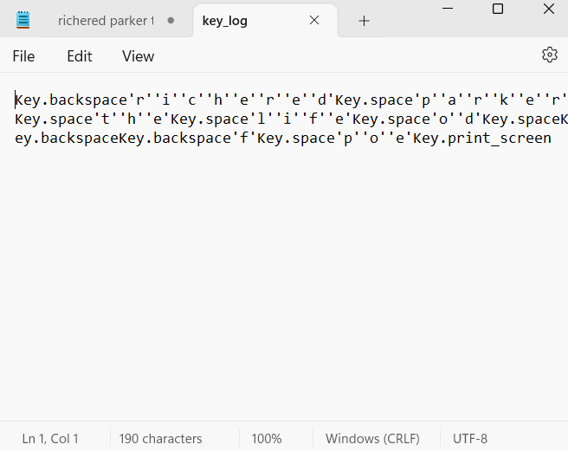
Code shows the module that loads the keystrokes of the keyboard the output stores in the another file named as “key log”
10

Slide 11
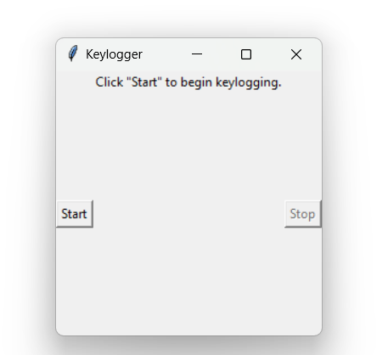
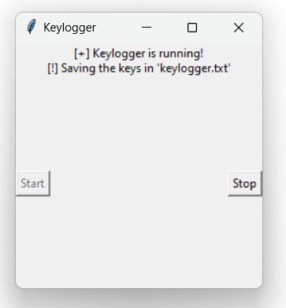
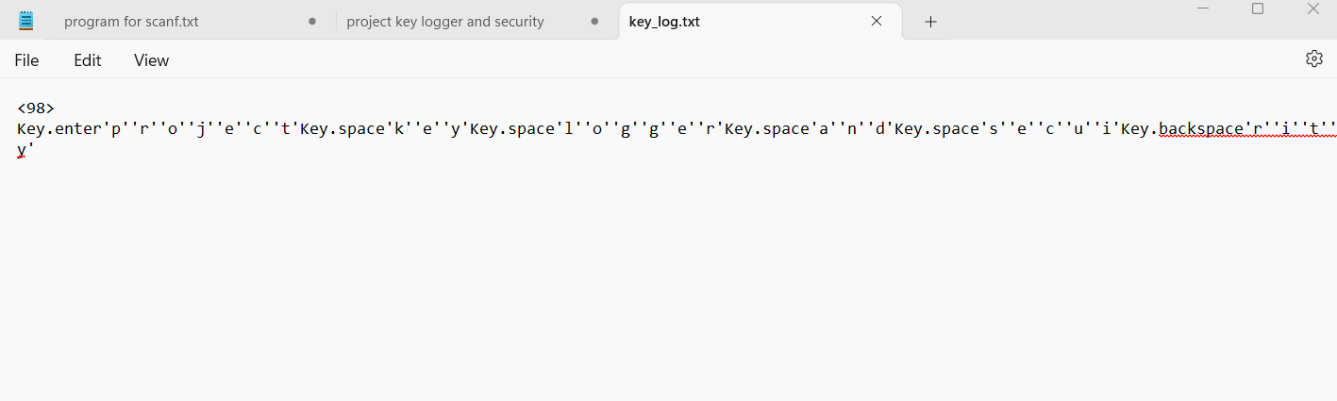
RESULTS

Slide 12
Achievements:
.Successfully developed a functioning keylogger.
.Captured and logged keystrokes in real-time.
.Demonstrated efficient and user-friendly interface.
Metrics:
.Accuracy: 100% keystroke capture.
.Performance: Real-time logging with no noticeable lag.
ease of use and utility.
6/13/2024 Annual Review 10

